Slide 1
Exploration on Yelp Reviews
Sentimental Analysis and Prediction
Group 1
Xinkai Chen
Wenbo Fei
Guanqi Lu
Lokeswar Sadasivuni

Slide 2
Outline Presentation 1
Data Analysis Plan
Overview of Data & Goal
Preliminary Analysis
Technical Detail

Slide 3
Data Analysis Plan

Slide 4
Data Analysis Plan
Information Extraction
Detailed aspects people care about: food, service, etc.
Words and categories appear most in tips.json, review.json
Sentimental Analysis
Do sentimental analysis and generate feature value for each review
Summarize keywords and user’s sentiments towards it from review.json
Weighting &
Normalization
Assign each review a weight
Use user portrait from user.json and review length and date from review.json
Predict & Comparison
Review features combined with business.json
Predict overall and detailed ratings, give suggestion

Slide 5
Overview of Data & Goal

Slide 6
Overview of Raw Data
We have four data sets:
business.json
location, attributes, and categories data of business
3 of top 10 states with most businesses come from Canada- ON,QC,AB
Chinese cuisine is among the most popular category
review.json
full review text data including ratings
user.json
metadata associated with the user and their friend mapping
tips.json
quick suggestions provided by users

Slide 7
Our Goal
Chinese restaurants in Canada
We have 1066 such businesses with review number over 10 in our datasets.
Predicting rates of detailed aspects of each restaurants, food, service, etc.
Providing suggestion on how to improve restaurants users’ rating and profits.

Slide 8
Preliminary Analysis – Info Extraction

Slide 9
Preliminary Analysis – Info Extraction
Adjust words to lower cases
Tokenize text
Remove one letter words/ numbers
Remove stop words
Lemmatize the text
Example：
Raw Review:
'Limited menu, but what they do, they do well. Portions are very generous, broth is delicious, noodles are perfect.’
Cleaned Review:
'limited menu well portion generous broth delicious noodle perfect'

Slide 10
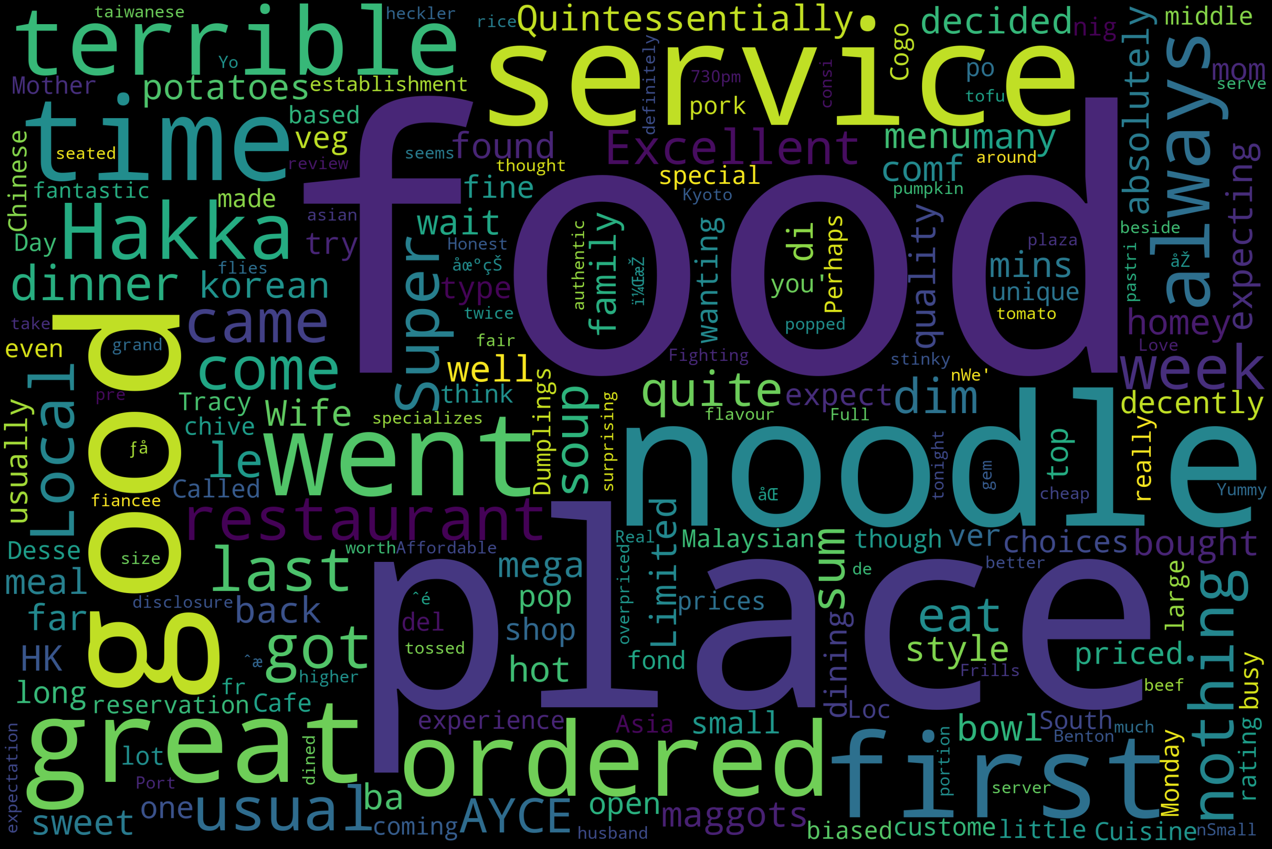
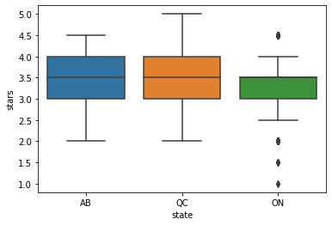
Preliminary Analysis - Overview
Figure 1. word Cloud of all the reviews
Figure 2. Ratings across states

Slide 11
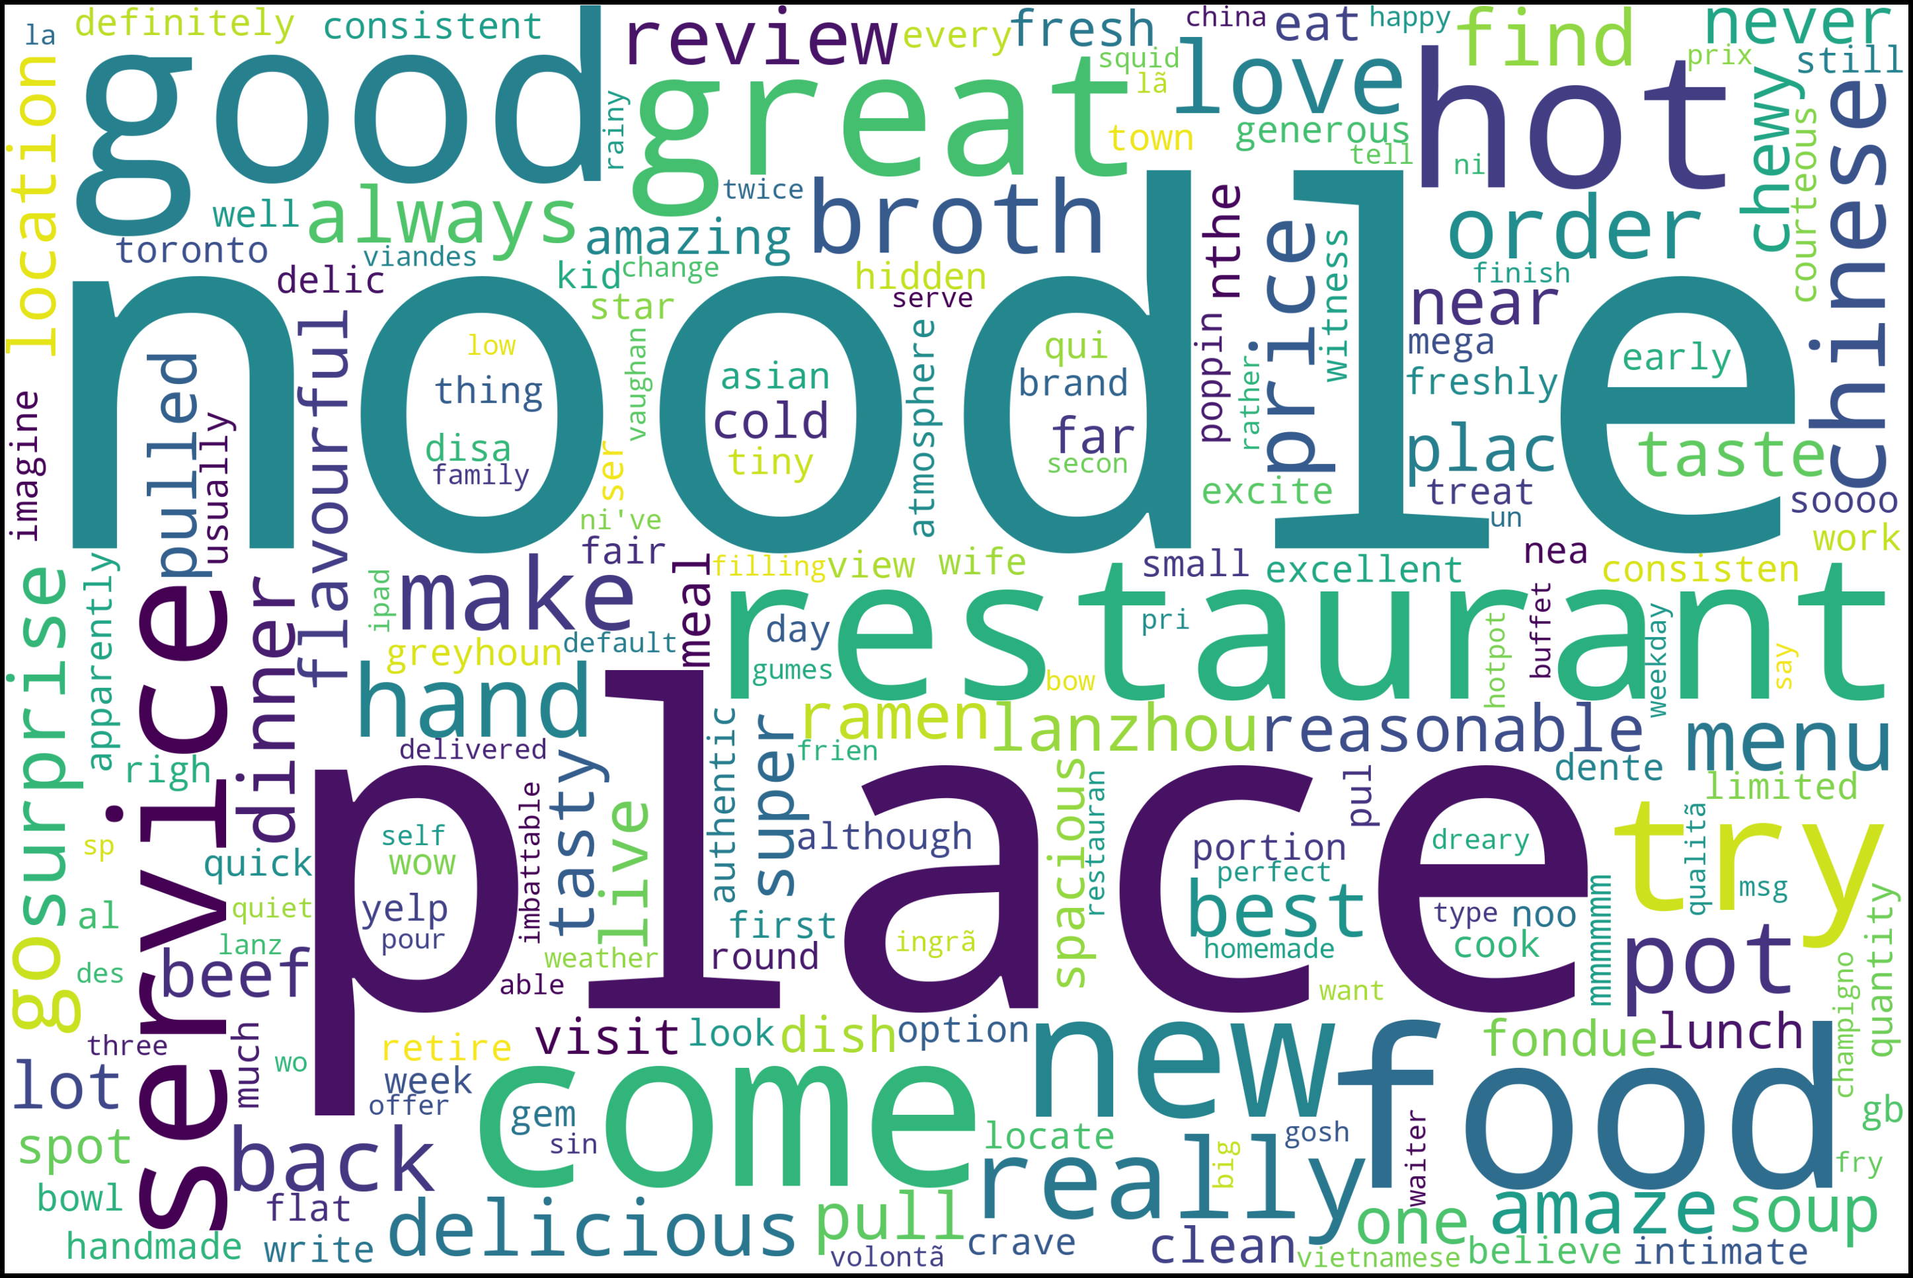
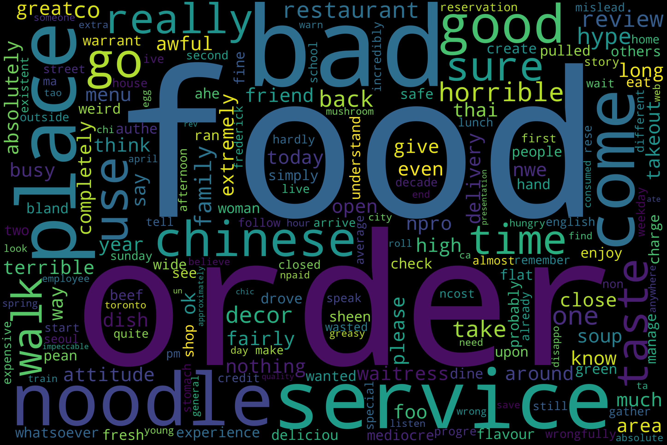
Preliminary Analysis – Bad reviews v.s Good reviews
Figure 3. Word cloud of good reviews
Figure 4. Word cloud of bad reviews

Slide 12
Technical Detail - Sentimental Analysis

Slide 13
Aspect-Based Sentiment Analysis (ABSA)
Task 1:
Aspect Term Extraction
Task 2:
Aspect Term Polarity
Task 3:
Aspect Category Detection
Task 4:
Aspect Category Polarity

Slide 14
Technical Detail - Example
This was my first time here and i decided to order the shrimp wonton soup. The soup itself was basic and came with 4 decent sized wontons, nice and hot. They also have a self serve tea section. The service was fast. Im talking about placing our order and within 1 min my soup was on the table!

Slide 15
Technical Detail - Example
This was my first time here and i decided to order the shrimp wonton soup. The soup itself was basic and came with 4 decent sized wontons, nice and hot. They also have a self serve tea section. The service was fast. Im talking about placing our order and within 1 min my soup was on the table!
Task 1: Extract the aspect terms of interest
[‘wontons’, ‘service’ ]
Task 2: Determine whether the sentiment polarity of each aspect term is positive or negative
> Opinion
{’wontons’: [‘decent’, ‘nice’, ‘hot’], ‘service’: [‘fast’]}
> Sentimental_score
{’wontons’: 2.5, ‘service’: 1}

Slide 16
Technical Detail - Example
This was my first time here and i decided to order the shrimp wonton soup. The soup itself was basic and came with 4 decent sized wontons, nice and hot. They also have a self serve tea section. The service was fast. Im talking about placing our order and within 1 min my soup was on the table!
Task 3: Assign each aspect term to the aspect category
wontons → Food
service → Service
Task 4: Compute the sentiment score of each aspect category
{‘Food’: 4.0, ‘Service’: 3.0, …}

Slide 17
Thank You !

